Slide 1
Git Concepts and Workflows (for Googlers: go/git-explained) Edwin Kempin Google Munich ekempin@google.com
This presentation is based on a Git/Gerrit workshop that was developed by SAP.
Credits go to sasa.zivkov@sap.com, matthias.sohn@sap.com and christian.halstrick@sap.com
PUBLIC - SHARED WITH GERRIT COMMUNITY

Slide 2
Target Audience
This presentation is for:
Git beginners
Advanced Git users that want to consolidate their Git knowledge
Git users that start working with Gerrit Code Review
Required pre-knowledge:
Basic knowledge about software development and versioning systems.

Slide 3
Content
YES
NO
Git terminology
Git concepts
Git commands that are needed for daily work.
Basic Git workflows
Explanations of Git version graphs
Gerrit Code Review (covered by Gerrit - Concepts and Workflows presentation)
GitHub Pull Requests
Git internals (like git protocol)
Google specifics
git add, git alias, git bisect, git blame,
git branch, git cherry-pick, git checkout,
git clone, git commit, git commit --amend,
git diff, git fetch, git init, git log,
git merge, git notes, git pull, git push,
git push --force, git rebase, git rebase --interactive, git reflog,
git reset, git revert, git rm, git show,
git stash, git status, git submodule,
git tag

Slide 4
Agenda
Git Repository Structure
Making changes
Branches
Clone + Fetch
Merge, Rebase, Cherry-Pick
Push
Interactive Rebase
More Git

Slide 5
Welcome
Please ask questions immediately!
To make the presentation more interactive you will also be asked questions :-)
If you read through the slides and the answer to a question doesn’t get clear from the next slide, you can likely find it in the speaker notes.
?
?
?
?
?
Q: What’s a distributed versioning system?

Slide 6
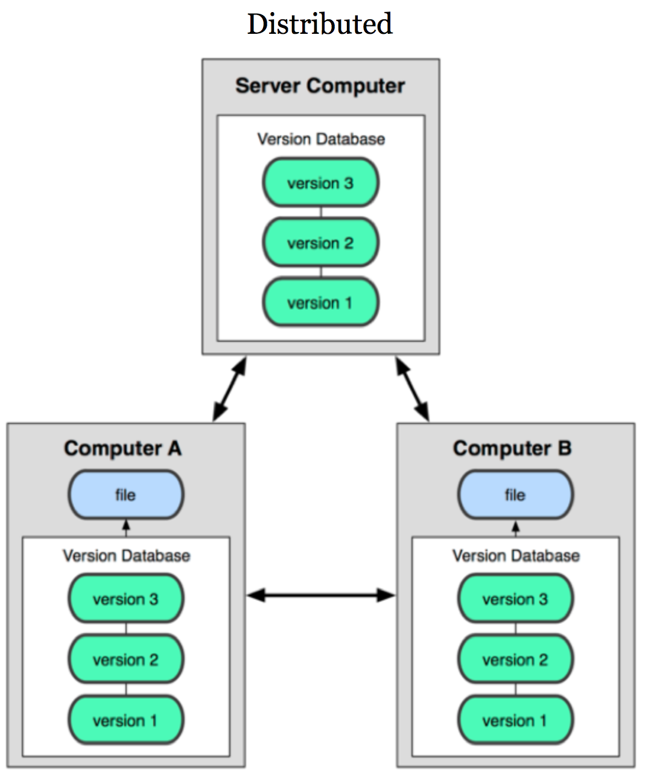
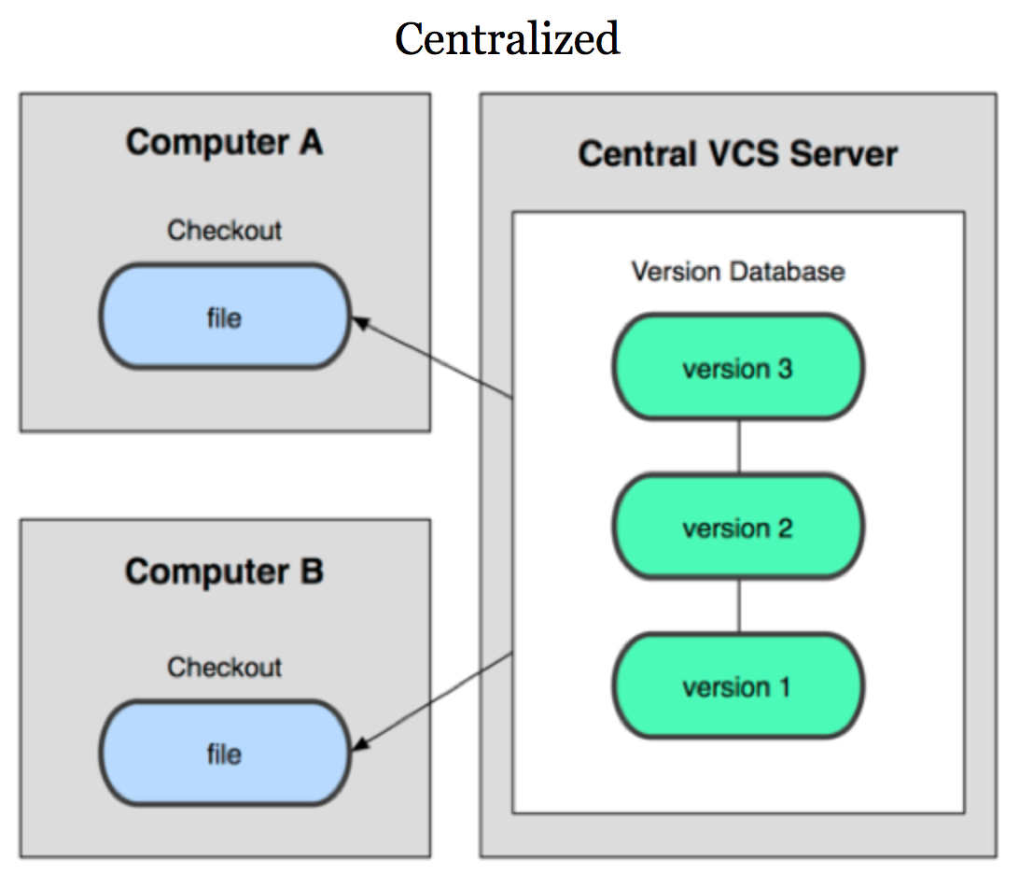
Distributed Versioning Systems
Distributed means:
each developer has a complete, local repository
technically the central repository is not different from the local repositories
easy offline usage
easy to branch a project
Examples: Git, Mercurial, Bazaar

Slide 7


Git
Created 2005 for Linux Kernel Development
Used for Linux, Android, Eclipse
Integration into Eclipse, Netbeans, XCode
GitHub (popular Git hosting)
Used at Google, SAP, Qualcomm, Ericsson, Sony, Wikimedia, Intel, NVIDIA, Twitter, Garmin, etc.

Slide 8
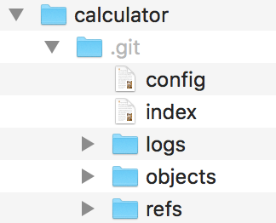

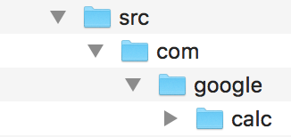
Git Repository Structure
A Git repository is created by:
git init
git clone (explained later)

Slide 9
Git Repository Structure
The .git folder contains the full version database.
Many files in the .git folder are human-readable.
.git folder is the Git repository

Slide 10
Git Repository Structure
A Git repository has at most one working tree.
.git folder is the Git repository
files/folders next to the .git folder are the working tree

Slide 11
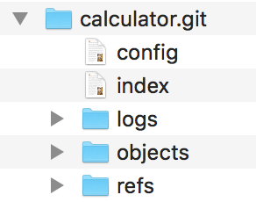
Git Repository Structure
A Git repository without working tree is called bare repository (used on servers).
Notes:
Bare repositories are used on server-side.

Slide 12
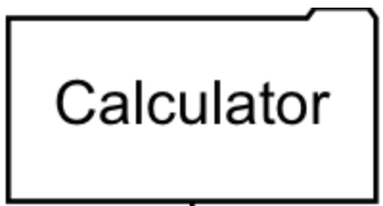
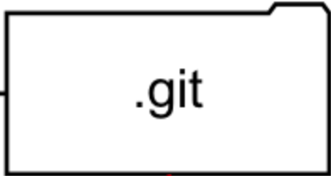
Checkout
Checkout:
populates the working tree with the commit you want to start working from
git checkout
<working tree>

Slide 13
Making Changes
Just start doing your changes:
modify, add, delete files
no need to tell Git which files you want to work on
tell Git which changes you intend to commit: git add <file> git rm <file>
<working tree>
Q: What happens on git add?

Slide 14

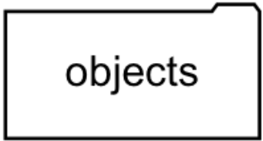
Making Changes
Index or Staging Area is where the next commit is prepared:
git add and git rm update the index
Stage single hunks: git add -p <file>
Unstage files: git reset HEAD <file>
.git
git add <file-name>
<working tree>
Notes:
Index and staging area are synonyms.

Slide 15
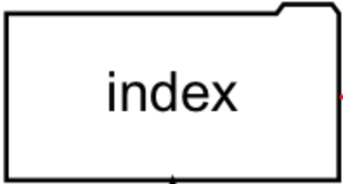
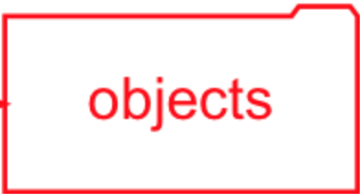
Making Changes
git commit commits staged changes only (the index)
There can still be non-staged changes in the working tree which will not be included into the commit.
.git
git commit
<working tree>
Notes:
commit is both a command and an object.

Slide 16
See what was changed
3 states:
commit that was checked out (HEAD)
index (staged modifications)
working tree (unstaged modifications)
git status shows changed paths
between index and commit that was checked out (HEAD)
between working tree and index
git diff shows file modifications
details on next slide
Notes:
git diff --staged and git diff --cached are synonyms.

Slide 17
See what was changed
.git
commit that was checked out (HEAD)
git diff --staged
git diff HEAD
git diff
<working tree>
Notes:
git diff --staged and git diff --cached are synonyms.
git diff HEAD^ - compare working dir against parent commit of HEAD

Slide 18
Commits
Imagine a project that contains 3 files: A, B and C
Commit 1
A
B
C

Slide 19
Commits
Each time changes are committed a new commit is created: Commit 1, Commit 2, Commit 3
Every commit is a full snapshot of the whole project.
time
Commit 1
Commit 2
Commit 3
A
A1
A1
B
B
B
C
C1
C2

Slide 20
Commits
Git optimizes the storage and will not create copies of non-modified files.
time
Commit 1
Commit 2
Commit 3
A
A1
A1
B
B
B
C
C1
C2

Slide 21
Commits
Same as previous slide, only the files are collapsed into snapshots now.
time
Commit 1
Commit 2
Commit 3
Snapshot 1
Snapshot 2
Snapshot 3

Slide 22
Commits
Each commit knows its parent.
time
Commit 1
Commit 2
Commit 3
Snapshot 1
Snapshot 2
Snapshot 3

Slide 23
Commit Object Structure
SHA1:
globally unique commit ID
40-digit hexadecimal number
function of the commit object content
shown in git log output etc.
To inspect a commit use:
git show <SHA1>
git show --format=fuller <SHA1>
Once created commits are immutable.
ID: 78ae51a
Parent: 6709af
Tree: 922b8c
Snapshot
Author: John Doe <jdoe@example.com>
Committer: John Doe <jdoe@example.com>
Commit Message
...
Q: What’s the difference between author and committer? When do they differ?

Slide 24
Author vs. Committer
Author:
person who wrote the patch
Committer:
person who created the commit, e.g. project maintainer who applied the patch
Git sets author and committer based on the user.name and user.email config values.
Author can be explicitly set on commit: git commit --author=<author>
Notes:
With Gerrit author and committer can differ if one person uploads a change and another person makes a fix to it and uploads a new patch set.

Slide 25
Commit Message
First line is the subject.
Separated by a blank line follows the body.
The last paragraph is for metadata (key-value pairs). The metadata is intended to be interpreted by tools.
First line is the subject, should be shorter than 70 chars
Separate the body from the subject by an empty line. The commit message should describe why you are doing the change. That's what typically helps best to understand what the change is about. The details of what you changed are visible from the file diffs. The body can have as many paragraphs as you want. Lines shouldn't exceed 80 chars. This helps command line tools to render it nicely. Paragraphs are separated by empty lines.
Bug: Issue 123

Slide 26
Commit History
C is a successor of B
B is a successor of A
The lines between the commits represent parent relationships, the arrows for parent relations are omitted.
Can be seen by:
git log (with file diffs)
git log --oneline (with subject only)
git log --graph (as graph)
gitk (as graph in Git repository browser)
C
time
B
A

Slide 27
Branches
A branch is a named pointer to a commit:
example: master
full name: refs/heads/master
All commits that are reachable from a branch following the parent pointers form the branch history.
The commit to which the branch points is also called branch tip.
master
C
B
A
Q: What happens when new changes are committed?
Notes:
All commits which are reachable from a branch form the history of the branch.
The refs/heads/ prefix can be omitted if the branch name is unique.
Creating branches is very cheap.
A branch is stored as a file that contains the SHA1 of the commit to which the branch points.

Slide 28
Branches
A new commit D gets created.
The branch is moved to point to the new commit.
D
master
master
C
B
A

Slide 29
Branches
Usually there are many branches in a Git repository:
Branches can point to the same commit.
Branches can be deleted: git branch -D <branchname>
There is nothing special about master, it’s just a normal local branch
origin/master is a remote tracking branch (explained later).
Branch creation is done by:
git branch <branchname>
git checkout -b <branchname>
List all branches:
git branch -a
D
feature1
master
F
bugfix15
C
G
E
feature2
origin/master
B
A
Q: How does Git know which branch should be updated on the next commit operation?

Slide 30
HEAD
HEAD points to the current branch:
git commit updates the current branch
git checkout sets the current branch
HEAD
D
feature1
master
F
bugfix15
C
G
E
feature2
origin/master
B
A
Q: What happens on git checkout bugfix15 ?

Slide 31
HEAD
git checkout:
moves HEAD
also updates the working tree
HEAD
HEAD
D
feature1
master
F
bugfix15
C
G
E
feature2
origin/master
B
A
Q: What if you started to make changes but you forgot to checkout the correct branch?

Slide 32
Checkout with changes in working tree
If you started to make changes to the working tree but the wrong branch is checked-out:
just try to checkout the correct branch, if there are no conflicts this will just work
if there are conflicts the checkout fails, in this case you can do: $ git stash $ git checkout <correct-branch> $ git stash pop $ <resolve conflicts> $ git stash drop
a working tree with modifications is called dirty
a working tree without modifications is called clean
git stash puts changes in a dirty working tree aside, with git stash pop they can be applied somewhere else (more about conflict resolution later)
Q: What if you have created a commit but you want to include additional changes?

Slide 33
Amend Commit
git commit --amend rewrites the last commit:
creates a sibling commit D of the last commit C and resets the current branch to it
the old commit message is preserved, but can be edited if wanted
the old commit C is still available in the repository
rewrites the history of the branch (you should never rewrite commits that have already been shared with others, since others may already have used it as base for other work)
HEAD
master
C
D
master
B
A

Slide 34
Resetting Branches
Branches can also be moved “manually” by git reset.
D
HEAD
master
C
B
A
Q: What happens when master is reset to commit B?

Slide 35
Resetting Branches
git reset B
Updates the current branch to point to commit B.
Commit C and D are no longer part of the history of the master branch.
master
D
git reset B
C
HEAD
master
B
A
Q1: What happens to the non-reachable commits C and D?

Slide 36
Non-reachable Commits
Non-reachable commits
are by default kept for 2 weeks
are garbage collected after the expiry time has passed and when git gc is run
Can be checked out by SHA1.
D
C
HEAD
master
B
A
Q: What happens if a non-reachable commit is checked-out?
Notes:
Prune time can be configured by setting gc.pruneExpire in the git config.

Slide 37
Detached HEAD
If HEAD points directly to a commit (instead of pointing to a branch) it’s called detached HEAD.
HEAD
D
C
HEAD
master
B
A
Q: What happens if a new commit is created now?

Slide 38
Detached HEAD
New commits can be created even if HEAD is detached:
If you checkout something else now the new commit gets unreachable (but you may still access it if you know its SHA1).
HEAD
E
HEAD
D
C
master
B
A

Slide 39
Resetting Branches
master
D
git reset B
C
HEAD
master
B
A
Q2: Where is the new commit created on git commit after reset?

Slide 40
New Commit after Reset
The new commit becomes successor of the commit to which the current branch points.
The current branch is updated.
D
HEAD
HEAD
C
E
master
master
B
A

Slide 41
Resetting Branches
master
D
git reset B
C
HEAD
master
B
A
Q3: What happens to the working tree and the index on branch reset?

Slide 42
Resetting Branches
The branch is always reset, whether the index and working tree are reset depends on the reset mode (soft, mixed, hard).
With git reset --hard local modifications in the working tree are lost.
git reset | branch | index | working tree
--soft | Yes | No | No
--mixed (default) | Yes | Yes | No
--hard | Yes | Yes | Yes
Q: What are use cases for the different reset modes?

Slide 43
Resetting Branches
Use cases:
git reset --hard: Discard all local modifications.
git reset --soft: Squash commits.
git reset --mixed: Split commits.
git reset | branch | index | working tree
--soft | Yes | No | No
--mixed (default) | Yes | Yes | No
--hard | Yes | Yes | Yes
Q: How is squashing and splitting commits by reset working?

Slide 44
Squash commits by soft reset
git checkout D: current branch points to D, index and working tree contain snapshot of D
git reset | branch | index | working tree
--soft | Yes | No | No
working tree
index
Snapshot D
D
master
C
B
A

Slide 45
Squash commits by soft reset
git checkout D: current branch points to D, index and working tree contain snapshot of D
git reset --soft B: current branch points to B, index and working tree still contain snapshot of D
git reset | branch | index | working tree
--soft | Yes | No | No
working tree
index
Snapshot D
D
master
C
B
master
A

Slide 46
Squash commits by soft reset
git checkout D: current branch points to D, index and working tree contain snapshot of D
git reset --soft B: current branch points to B, index and working tree still contain snapshot of D
git commit: new commit E is created from index state (snapshot of D)
Git interactive rebase is a better way to squash commits (explained later).
git reset | branch | index | working tree
--soft | Yes | No | No
working tree
index
Snapshot D
D
master
E
C
B
master
A

Slide 47
Split commits by mixed reset
git checkout C: current branch points to C, index and working tree contain snapshot of C
git reset | branch | index | working tree
--mixed (default) | Yes | Yes | No
working tree
index
Snapshot C
C
master
B
A

Slide 48
Split commits by mixed reset
git checkout C: current branch points to C, index and working tree contain snapshot of C
git reset --mixed B: current branch points to B, index contains snapshot of B, working tree still contains snapshot of C
git reset | branch | index | working tree
--mixed (default) | Yes | Yes | No
working tree
Snapshot C
C
master
Snapshot B
B
master
index
A

Slide 49
Split commits by mixed reset
git checkout C: current branch points to C, index and working tree contain snapshot of C
git reset --mixed B: current branch points to B, index contains snapshot of B, working tree still contains snapshot of C
git add <file> && git commit: Stage some modifications and commit.
git add <file> && git commit: Stage rest of modifications and commit.
git reset | branch | index | working tree
--mixed (default) | Yes | Yes | No
working tree
index
E
master
∆E
Snapshot C
C
D
∆C=∆D+∆E
∆D
B
master
A

Slide 50
Tags
A tag allows to tag a specific point in the version history:
normally used to tag important versions such as releases
in contrast to branches tags are immutable (well you can delete and recreate tags, but you really should not do this once they have been shared with others)
example: v1.0.0
full name: refs/tags/v1.0.0
HEAD
master
D
F
stable-1.0
C
E
v1.0.1
B
v1.0.0
A
Notes:
All commits which are reachable from a branch form the history of the branch.
The refs/heads/ prefix can be omitted if the branch name is unique.
Creating branches is very cheap.
A branch is stored as a file that contains the SHA1 of the commit to which the branch points.

Slide 51
Tags
There are 3 kind of tags:
lightweight tags (just a pointer to a commit)
annotated tags (full Git object, allows tags to have a message)
signed tags (tag with signature)
Tag creation:
git tag <tagname>
git tag -a <tagname>
git tag -s <tagname>
List tags:
git tag
HEAD
master
D
F
stable-1.0
C
E
v1.0.1
B
v1.0.0
A
Notes:
All commits which are reachable from a branch form the history of the branch.
The refs/heads/ prefix can be omitted if the branch name is unique.
Creating branches is very cheap.
A branch is stored as a file that contains the SHA1 of the commit to which the branch points.

Slide 52
B-R-E-A-K

Slide 53
Clone
remote repository
local repository
A remote repository can be cloned to a client by git clone <URL>
HEAD
master
D
F
stable-1.0
C
E
B
A
git clone <URL>
Q: What happens on git clone? Which commits does the client get? Which branches?

Slide 54
Clone
remote repository
local repository
The client gets all (reachable) commits.
From the client’s perspective the branches in the remote repository are remote branches.
For each remote branch a remote tracking branch is created in the local repository (e.g. origin/master and origin/stable-1.0).
For the remote branch to which HEAD points a local branch is created and checked out (normally master).
The repository URL is stored in the git config under a name, by default the remote repository is called origin.
HEAD
HEAD
origin/master
master
D
F
stable-1.0
master
D
F
origin/stable-1.0
C
E
C
E
B
B
A
A
git clone <URL>
Q: How are remote tracking branches different from local branches?

Slide 55
Clone
remote repository
local repository
A remote tracking branch
tracks the state of a remote branch in the local repository
is only updated by git fetch and is otherwise read-only
HEAD
HEAD
origin/master
master
D
F
stable-1.0
master
D
F
origin/stable-1.0
C
E
C
E
B
B
A
A
Q: What happens when a remote branch is updated?

Slide 56
Clone
remote repository
local repository
changes in the remote repository are only reflected in the local repository on git fetch
HEAD
G
HEAD
origin/master
master
master
D
F
stable-1.0
master
D
F
origin/stable-1.0
C
E
C
E
B
B
A
A
Q: What happens on fetch?

Slide 57
Fetch
remote repository
git fetch
fetches new commits
updates the remote tracking branches
never updates local branches
never changes the working tree
is always safe to do
FETCH_HEAD points to the commit that was fetched last
local repository
origin/master
HEAD
G
HEAD
G
FETCH_HEAD
master
D
F
stable-1.0
master
D
F
origin/stable-1.0
C
E
C
E
B
B
A
A
Q: How do local branches get updated?
Notes:
Answer: Local branches get updated by merge or rebase.

Slide 58
Merge
HEAD
master
D
F
featureX
C
E
B
A
Q: What is the result of merging the featureX branch into the master branch? Which branch is updated?

Slide 59
Merge
HEAD
git merge featureX:
Merges featureX into the current branch (master).
Creates a merge commit (commit with more than one parent).
The current branch is updated.
master
G
master
D
F
featureX
C
E
B
A
Q: Which commits belong to the history of the master branch? What if master was merged into featureX?
Notes:
Answers:
All commits belong to the history of the master branch.
A, B, E, F belong to the history of the featureX branch.
If the merge was done in the opposite direction the featureX branch would have been update to point to the merge commit G. Content-wise the result would be the same, but which commit is first and which commit is second parent is switched (relevant for git log --first-parent and Gerrit).

Slide 60
Merge
C
featureX
HEAD
master
B
A
Q: What will be the result of merging featureX into master?

Slide 61
Merge - Fast-Forward
Fast forward merge:
Just moves the branch pointer.
No creation of a merge commit.
The creation of a merge commit can be enforced by: git merge --no-ff
HEAD
master
C
featureX
master
B
A

Slide 62
Merge
On merge Git automatically tries to do a content merge and reports conflicts only if the same lines (+ some context) in the same file have been touched.
HEAD
master
D
F
featureX
C
E
B
A
Q: What if there are conflicting modifications in master and featureX?

Slide 63
Merge - Conflict Resolution
If there are conflicts:
the merge operation stops and leaves you with a dirty working tree, the conflicting files contain conflict markers
Use git status to see which files have conflicts.
Resolve the conflicts manually by editing the files or accept either version by:
git checkout --ours <file>
git checkout --theirs <file>
after resolving the conflicts the conflict resolution must be staged by git add
once all conflict resolutions are staged continue with git commit
to abort the merge do git reset --hard
Tip:
To see the common ancestor version use merge.conflictstyle=diff3 (git config setting)
Conflicts markers (default):
<<<<<<< HEAD
foo
=======
bar
>>>>>>> featureX
Conflicts markers with common ancestor
version:
<<<<<<< HEAD
foo
||||||| merged common ancestors
baz
=======
bar
>>>>>>> featureX

Slide 64
Cherry-Pick
Imagine that:
commit E implements a feature
commit F is bug-fix
the bug-fix F is needed in master
HEAD
master
D
F
featureX
C
E
B
A
Q: How can only the bug-fix be brought into master? Why does merge not work?
Notes:
Answers:
Use cherry-pick
Merge cannot be used because it would also integrate the feature done by commit E into the master branch, which is not wanted.

Slide 65
Cherry-Pick
HEAD
Cherry-Pick:
Applies the modifications that were done by the commit that is cherry-picked (the commit delta) to a new base.
The commit message is preserved.
The new commit has no parent relation to the commit that was cherry-picked.
The cherry-pick can fail with conflicts. The conflict resolution is done the same way as for conflicts on merge.
master
G
∆F
D
F
featureX
∆F
C
E
∆E
B
A
Q: What is git rebase?
Notes:
After a cherry-pick from the Git graph one cannot know that G is a cherry-pick of F (with Gerrit this relation is not lost due to the Change-Id).

Slide 66
Rebase
Rebase:
redo the work that was done in the featureX branch on top of the master branch
HEAD
master
D
F
featureX
C
E
B
A

Slide 67
Rebase
Rebase:
rebases the current branch to a another base commit
rebase = series of cherry-picks
git rebase master rebases all commits of the featureX branch (which is currently checked out) onto the master branch.
the commit messages are preserved
the history of the featureX branch is rewritten, this is bad if the featureX branch is shared and others have based work on top of it
the old commits E and F still exist in the repository
after the rebase a fast-forward of master is possible
Linear history
ORIG_HEAD points to the old HEAD
H
featureX
HEAD
∆F
G
ORIG_HEAD
∆E
master
D
F
featureX
∆F
C
E
∆E
B
A
Q: How is conflict resolution on rebase different from resolving conflicts on merge?

Slide 68
Rebase - Conflict Resolution
For each commit that is rebased there can be conflicts:
the rebase operation stops at the commit that has conflicts and leaves you with a dirty working tree, the conflicting files contain conflict markers
Use git status to see which files have conflicts.
Resolve the conflicts manually by editing the files or accept either version by:
git checkout --ours <file>
git checkout --theirs <file>
after resolving the conflicts the conflict resolution must be staged by git add
once all conflict resolutions are staged continue with git rebase --continue
to abort the rebase do git rebase --abort
H
featureX
HEAD
∆F
G
ORIG_HEAD
∆E
master
D
F
featureX
∆F
C
E
∆E
B
A
Q: What is git pull?

Slide 69
Pull
Pull:
git pull can be configured to do git fetch + git rebase instead (config parameter pull.rebase=true)
git pull = git fetch + git merge FETCH_HEAD
Notes:
git pull definition can differ for each branch.

Slide 70
Push
Push:
pushes commits from the local repository to a remote repository (more precisely from a local branch to a remote branch)
git push origin HEAD:master is equivalent to git push origin HEAD:refs/heads/master
git push origin master is equivalent to git push origin refs/heads/master:refs/heads/master
git push origin HEAD:master
Name of remote repository to which the push is done.
What’s pushed to the remote repository (branch, commit, HEAD = current branch).
Destination in the remote repository (target branch).
Notes:
git push origin master is equivalent to git push origin master:master which is equivalent to git push origin refs/heads/master:refs/heads/master

Slide 71
Push
local repository
remote repository
Situation:
The remote repository was cloned, a local featureX branch was created and in this branch a commit C was created.
HEAD
featureX
C
B
origin/master
master
B
A
A
git push origin HEAD:master
Q: What happens on git push?

Slide 72
Push
local repository
remote repository
Push:
pushes commit C to the remote repository
updates the master branch in the remote repository
The local branch name is never transferred to the remote repository.
HEAD
master
C
featureX
C
B
origin/master
master
B
A
A
git push origin HEAD:master

Slide 73
Push
local repository
remote repository
Situation:
The remote repository was cloned, a local featureX branch was created and in this branch two commits, C and D, were created.
HEAD
featureX
D
C
B
origin/master
master
B
A
A
git push origin HEAD:master
Q: Which commits get pushed?

Slide 74
Push
local repository
remote repository
Push:
pushes all commits which are reachable from the pushed commit and which are not available in the remote repository
HEAD
master
D
featureX
D
C
C
B
origin/master
master
B
A
A
git push origin HEAD:master

Slide 75
Push
local repository
remote repository
Situation:
The remote repository was cloned, a local featureX branch was created and in this branch a commit C was created. In the meantime master in the remote repository was updated to commit D.
HEAD
featureX
C
master
D
B
origin/master
B
A
A
Q: What happens on push?

Slide 76
Push
local repository
remote repository
git push fails if the target branch cannot be fast-forwarded to the pushed commit.
HEAD
featureX
C
master
D
B
origin/master
B
A
A
Q: What happens on force push?

Slide 77
Force Push
local repository
remote repository
Force push:
Makes the push succeed even if the target branch cannot be fast-forwarded.
The target branch is updated to the pushed commit, conflicting commits are removed from the history of the target branch!
After the force push commit D is no longer contained in the history of the master branch.
HEAD
featureX
C
master
D
C
master
B
origin/master
B
A
A
git push --force origin HEAD:master
Q: How can the push succeed without discarding commit D?

Slide 78
Possibility 1: fetch, merge, push
local repository
remote repository
Situation:
Commit C cannot be pushed because the master branch in the remote repository cannot be fast-forwarded to it (it conflicts with commit D).
HEAD
featureX
C
master
D
B
origin/master
B
A
A

Slide 79
Possibility 1: fetch, merge, push
local repository
remote repository
git fetch origin: Retrieves commit D and updates the remote tracking branch.
HEAD
featureX
C
D
master
D
B
B
origin/master
A
A

Slide 80
Possibility 1: fetch, merge, push
local repository
remote repository
git fetch origin: Retrieves commit D and updates the remote tracking branch.
git merge origin/master: Merges commit D into the featureX branch.
HEAD
featureX
E
C
D
master
D
B
B
origin/master
A
A

Slide 81
Possibility 1: fetch, merge, push
local repository
remote repository
git fetch origin: Retrieves commit D and updates the remote tracking branch.
git merge origin/master: Merges commit D into the featureX branch.
git push origin HEAD:master: Push of commit E succeeds now because the master branch can be fast-forwarded to it.
HEAD
featureX
E
master
E
C
D
C
D
B
B
origin/master
A
A

Slide 82
Possibility 2: fetch, rebase, push
local repository
remote repository
Situation:
Commit C cannot be pushed because the master branch in the remote repository cannot be fast-forwarded to it (it conflicts with commit D).
HEAD
featureX
C
master
D
B
origin/master
B
A
A

Slide 83
Possibility 2: fetch, rebase, push
local repository
remote repository
git fetch origin: Retrieves commit D and updates the remote tracking branch.
HEAD
featureX
C
D
master
D
B
B
origin/master
A
A

Slide 84
Possibility 2: fetch, rebase, push
local repository
remote repository
git fetch origin: Retrieves commit D and updates the remote tracking branch.
git rebase origin/master: Rebases commit C onto the commit D which creates commit E.
HEAD
featureX
E
∆C
C
D
master
D
∆C
B
B
origin/master
A
A

Slide 85
Possibility 2: fetch, rebase, push
local repository
remote repository
git fetch origin: Retrieves commit D and updates the remote tracking branch.
git rebase origin/master: Rebases commit C onto the commit D which creates commit E.
git push origin HEAD:master: Push of commit E succeeds now because the master branch can be fast-forwarded to it.
HEAD
featureX
E
master
E
∆C
C
D
D
∆C
B
B
origin/master
A
A

Slide 86
Differences between merge and rebase
Content-wise the result is exactly the same in both cases. In both cases the same number of conflicts needs to be resolved.
With merge:
Two commits, commit C which implements the feature and the merge commit E (may contain conflict resolution).
Diverged history.
From the history one can see that commit C was originally developed based on commit B.
With rebase:
Single commit, it looks like commit C was developed based on commit D.
Linear history.
remote repository after fetch, merge, push
remote repository after fetch, rebase, push
master
E
master
E
C
D
D
B
B
A
A
Q: What is better, merge or rebase?
Notes:
Answer: Neither, it depends on the use-case and on personal preferences.

Slide 87
B-R-E-A-K

Slide 88
Interactive Rebase
Situation:
in the local branch featureX three commits, C, D and E, have been done to implement a feature
the commits have not been pushed yet
Interactive rebase
rewrites the last n commits
allows to update, squash, split commits while they are rewritten
rewrites the history of the branch (you should never rewrite commits that have already been shared with others)
git rebase --interactive HEAD~3
First commit in the history that should not be rewritten.
featureX
E
Opens editor with rewrite plan
D
HEAD
C
pick 7888debe88 C
pick 0a12290e7b D
pick deb7e4d61f E
B
origin/master
A
Commands that should be executed for the commits
SHA1’s and subjects of the commits that should be rewritten, oldest commit first!

Slide 89
Interactive Rebase
Possible commands:
pick (default): Cherry-pick the commit unchanged.
reword: Rewrite the commit message of the commit.
edit: Stop at this commit so that it can be rewritten by git commit --amend, continue rebase by git rebase --continue
squash: Squash the commit into the predecessor commit. Allows to edit the combined commit message.
fix: Same as squash, but automatically takes the commit message of the predecessor commit.
Before interactive rebase:
git rebase --interactive HEAD~3
pick 7888debe88 C
squash 0a12290e7b D
pick deb7e4d61f E
featureX
E
D
HEAD
C
After interactive rebase:
E
∆E
G
featureX
B
origin/master
D
∆E
∆D
F
A
C
HEAD
∆C
∆C + ∆D
B
origin/master
A

Slide 90
Interactive Rebase
Interactive rebase also allows to reorder and drop commits. For this simply change the order of the lines in the interactive rebase editor, deleting a line means that this commit is dropped. Additional commits can be inserted by using edit on a commit and then creating new commits with git commit (rather than amending the commit with git commit --amend).
Conflicts can appear on each stage of the interactive rebase:
if applying a commit results in conflicts the interactive rebase stops at this point, conflicting files have conflict markers, after the conflict resolution is staged you can continue the rebase by: git rebase --continue
the interactive rebase can be aborted by: git rebase --abort
Before interactive rebase:
git rebase --interactive HEAD~3
pick 0a12290e7b D pick 7888debe88 C
pick deb7e4d61f E
featureX
E
D
HEAD
H
featureX
C
After interactive rebase:
E
∆E
∆E
G
B
origin/master
D
HEAD
∆C
∆D
F
A
C
∆C
∆D
B
origin/master
A

Slide 91
Blame
git blame <file> shows for each line in the file when it was last modified, by whom and by which commit.
If a bug is spotted git blame can help to find out by which commit the bug was introduced. Once the bad commit is identified you can use git branch -r --contains <bad-commit> to find all branches which contain the bug and may need to be fixed.
...
07952c069ab (Edwin Kempin 2016-04-07 14:00:17 +0200 81) SshKeyCache sshKeyCache,
07952c069ab (Edwin Kempin 2016-04-07 14:00:17 +0200 82) AccountCache accountCache,
07952c069ab (Edwin Kempin 2016-04-07 14:00:17 +0200 83) AccountByEmailCache byEmailCache,
54ba43a51dc (Dave Borowitz 2014-11-25 14:41:05 -0500 84) AccountLoader.Factory infoLoader,
2461265e486 (Michael Ochmann 2016-02-12 17:26:18 +0100 85) DynamicSet<AccountExternalIdCreator> extIdCreators,
07952c069ab (Edwin Kempin 2016-04-07 14:00:17 +0200 86) AuditService auditService,
744d2b89671 (Edwin Kempin 2017-02-15 11:10:59 +0100 87) ExternalIdsUpdate.User externalIdsUpdateFactory,
07952c069ab (Edwin Kempin 2016-04-07 14:00:17 +0200 88) @Assisted String username) {
...

Slide 92
Bisect
git bisect finds the commit that has introduced a bug by doing a binary search over the git history:
$ git bisect start $ git bisect bad $ git bisect good <last-known-good>
Now git bisect will checkout different commits and for each of them you should probe whether the bug is present and then tell git bisect whether the commit is good (git bisect good) or bad (git bisect bad). If a commit cannot be probed skip it (git bisect skip). The probing of commits can be automated by a script. At the end git bisect will present you the first bad commit that introduced the bug.
HEAD
Z
master
X
master branch is known to be broken
Y
...
X
...
C
B
OK
at commit B it was still working
A

Slide 93
Revert
git revert undos the changes that have been done by a commit by creating a new commit that applies the inverted changes.
HEAD
E
master
D
C
X
commit C introduced a bug
B
A

Slide 94
Revert
git revert may fail due to conflicts. After resolving the conflicts and staging the conflict resolution you can create the revert commit by git commit.
HEAD
F
master
-∆C
E
master
D
C
X
commit C introduced a bug
∆C
B
A

Slide 95
Reflog
git reflog <branch> shows the log for a branch:
From the log you can see how the branch pointer was changed over time and by which commands.
It allows you to find commits to which you have lost reference.
Commits that are referenced by a reflog are not garbage-collected.
You can also see the reflog for HEAD: git reflog
a9456bf (HEAD, origin/master, origin/HEAD) HEAD@{0}: checkout: moving from 5ff36200b29567118b3aede8e49ba0b6c6b1adb1 to a9456bfdb862dfa7197583decac3c22149ae8109
5ff3620 (origin/stable-2.16) HEAD@{1}: checkout: moving from 5d607a4193fb41b4ad8fe01622f7e002fd4208c0 to 5ff36200b29567118b3aede8e49ba0b6c6b1adb1
5d607a4 HEAD@{2}: checkout: moving from a9456bfdb862dfa7197583decac3c22149ae8109 to 5d607a4193fb41b4ad8fe01622f7e002fd4208c0
a9456bf (HEAD, origin/master, origin/HEAD) HEAD@{3}: merge origin/stable-2.16: Merge made by the 'recursive' strategy.
5d607a4 HEAD@{4}: checkout: moving from 5ff36200b29567118b3aede8e49ba0b6c6b1adb1 to 5d607a4193fb41b4ad8fe01622f7e002fd4208c0
5ff3620 (origin/stable-2.16) HEAD@{5}: merge origin/stable-2.15: Merge made by the 'recursive' strategy.
53333b3 (tag: v2.16.2, tag: v2.16.1) HEAD@{6}: checkout: moving from 5d607a4193fb41b4ad8fe01622f7e002fd4208c0 to 53333b3e3f70dfe14ce4c937246a00a2e4bfa3a0
5d607a4 HEAD@{7}: checkout: moving from 951d84b32e4f2393dbcf7c319e0d3f617838948c to 5d607a4193fb41b4ad8fe01622f7e002fd4208c0
...

Slide 96

Submodules
Submodules are used to embed sub repositories into a super repository:
For each submodule the .gitmodules file in the super repository contains the URL of the sub repository and the local path to where it should be checked out.
The commits in the super repository contain git links to a commit in the sub repository.
The submodule commit is checked out at the local path that is defined in the .gitmodules file.
super repository
sub repository
master
D
3
master
C
2
B
1
A
Q: What are use cases for submodules?

Slide 97
Submodules
Separate code into different repositories:
E.g. create submodules for components of a project.
Cleaner Git history since commits are specific to a certain submodule/component.
Different maintainers, release cycles etc.
A submodule can be added to multiple repositories:
Multiple projects can share the same components.
A submodule is added by git submodule add <URL> <local-path>
Checks out the submodule repository at local-path (by default its master branch).
Creates/updates the .gitmodules file and creates a git link at local-path.
The git link and the .gitmodules file should be committed and pushed.
Users who fetch a commit with a new submodule must initiate the submodule by git submodule init
Q: How is a submodule updated?

Slide 98
Submodule Update
Submodule update:
Create a new commit in the sub repository.
super repository
sub repository
4
master
master
D
3
master
C
2
B
1
A

Slide 99
Submodule Update
Submodule update:
Create a new commit in the sub repository.
Update the git link in the super repository to point to the new commit 4 in the sub repository and create a new commit E.
Push the changes of both repositories. Users that fetch commit E in the super repository must update their checked out submodule by git submodule update
super repository
sub repository
4
master
master
E
3
master
D
2
C
1
B
A
Notes:
With Gerrit submodule subscriptions the super repository can be updated automatically when the sub repository changes.

Slide 100
Submodules
Tips:
Use git submodule update --init to initiate and update your submodules at once
Submodules may contain submodules themselves. In this case the submodule initiation and update can be done recursively by git submodule update --init --recursive

Slide 101
Branches without common ancestor
Within one repository it is possible to have branches that don’t share any common ancestor (e.g. contain a completely different set of files):
An orphan branch can be created by git checkout --orphan <branch-name>
HEAD
master
D
F
featureX
C
E
homepage
3
B
2
A
1

Slide 102
Notes
Notes allow to attach metadata to commits:
can be created/updated without touching the commit (and hence without changing its SHA1)
are stored in a separate notes branch (by default refs/notes/commits)
notes branches live in the refs/notes/ namespace and don’t share ancestors with normal branches
a notes branch contains a list of notes, the file name of a note is the SHA1 of the commit to which the note belongs, the metadata is stored as content in the note file (note that files in a notes branch may be sharded over multiple directories)
git notes allows to list, create and modify notes, but notes branches can also be checkout and updated like any other branch
you can see notes in the git history by git log --show-notes=<notes-branch>
HEAD
master
D
F
featureX
C
E
Files in notes branch:
B
refs/notes/commits
2
A → Reviewed-by: ... C → Reviewed-by: ...
A
1
A → Reviewed-by: ...

Slide 103
Git Configuration
List configuration options (overlayed, user global, system wide):
git config -l
git config -l --global
git config -l --system
Set an option (for current repository, user global, system wide):
git config user.name “John Doe”
git config --global user.name “John Doe”
git config --system user.name “John Doe”
Open the config file for edit (for current repository, user global, system wide):
git config -e
git config -e --global
git config -e --system
3 levels of configuration:
system wide: <git-inst>/etc/gitconfig
user global: $HOME/.gitconfig
repository specific: .git/config

Slide 104
Alias
Examples:
git config --global alias.co checkout makes git co the same as git checkout
git config --global alias.unstage 'reset HEAD --' makes git unstange <file> the same as git reset HEAD -- <file>
git config --global alias.visual '!gitk' makes git visual the same as gitk
git alias
allows to define own git commands
‘--’ is a bash feature to signify the end of command options, after which only positional parameters are accepted
use ‘!’ to invoke external commands

Slide 105
Thank You - Questions?
?
?
?
?
?

Slide 106
Go Links (for Googlers only)
TOPIC | GO LINK
Alias | go/git-explained@alias
Amend | go/git-explained@amend go/git-explained@commit-amend
Bisect | go/git-explained@bisect
Blame | go/git-explained@blame
Branches | go/git-explained@branches
Checkout | go/git-explained@checkout
Cherry-Pick | go/git-explained@cherry-pick
Clone | go/git-explained@clone
Commit History | go/git-explained@commit-history
Commit Message | go/git-explained@commit-message
Commits | go/git-explained@commits
TOPIC | GO LINK
Config | go/git-explained@config
Detached HEAD | go/git-explained@detached-HEAD
Diff | go/git-explained@diff
Differences between Merge and Rebase | go/git-explained@merge-vs-rebase
Fast-Forward Merge | go/git-explained@fast-forward, go/git-explained@fast-forward-merge
Fetch | go/git-explained@fetch
Force Push | go/git-explained@force-push
Git Repository Structure | go/git-explained@repo-structure, go/git-explained@repository-structure
HEAD | go/git-explained@HEAD

Slide 107
Go Links (for Googlers only)
TOPIC | GO LINK
Interactive Rebase | go/git-explained@rebase-interactive, go/git-explained@interactive-rebase
Merge Conflict Resolution | go/git-explained@conflict-resolution, go/git-explained@conflicts, go/git-explained@conflict-resolution-merge
Merge | go/git-explained@merge
Notes | go/git-explained@notes
Orphan Branch | go/git-explained@orphan-branch
Pull | go/git-explained@pull
Push: Conflict Resolution by Merge | go/git-explained@push-conflict-resolution-merge
Push: Conflict Resolution by Rebase | go/git-explained@push-conflict-resolution-rebase
TOPIC | GO LINK
Push | go/git-explained@push
Rebase Conflict Resolution | go/git-explained@conflict-resolution-rebase
Rebase | go/git-explained@rebase
Reflog | go/git-explained@reflog
Reset | go/git-explained@reset
Reset Modes | go/git-explained@reset-modes
Revert | go/git-explained@revert
Stash | go/git-explained@stash
Status | go/git-explained@status
Submodule | go/git-explained@submodule
Tags | go/git-explained@tags

Slide 108
License
This presentation is part of the Gerrit Code Review project and is published under the Apache License 2.0.

